Slide 1

Armed Forces College of Medicine
AFCM

Slide 2
3518 Arrhythmias AF and stroke prevention Syncope 3rd Year
Dr. Ahmed Al-Habbaa, MD, FESC
Assistant Professor of Cardiology
Al-Azhar University and AFCM

Slide 3
Intended Learning Outcomes (ILOs)
By the end of the lecture the student will be able to:
Recognize the basics of arrhythmias.
Recognize how to diagnose important types of arrhythmias.
Recognize how to assess the risk of thromboembolism in AF.
Recognize how to prevent the risk of thromboembolism in AF.
Recognize definition of syncope.
Recognize the common etiologies of syncope.
Recognize the proper investigations to diagnose syncope.
Recognize how to treat syncope.

Slide 4
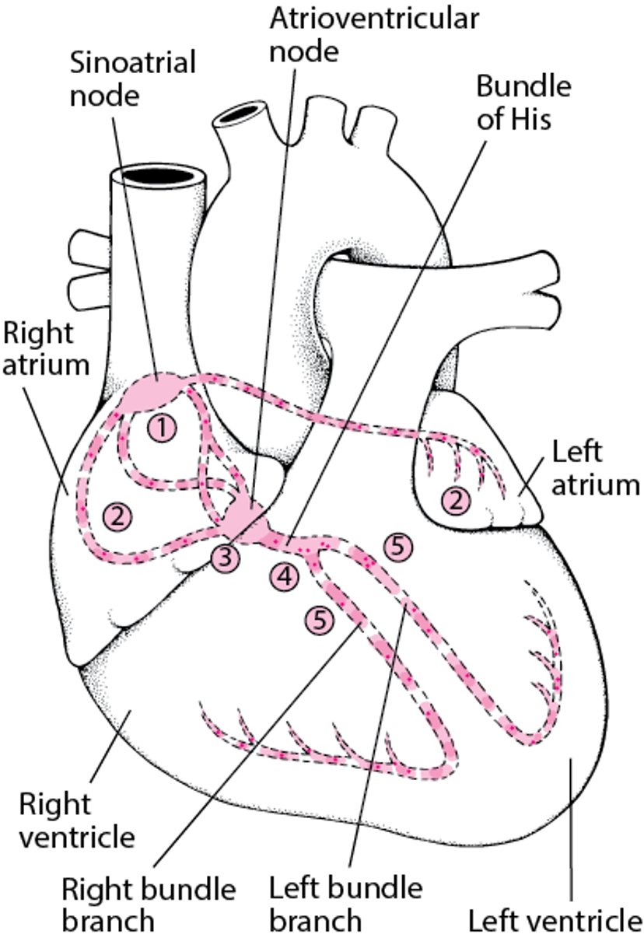
Overview of Arrhythmias
Electrical Pathway Through the Heart
The sinoatrial (sinus) node (1) initiates an electrical impulse that flows through the right and left atria (2), making them contract. When the electrical impulse reaches the atrioventricular node (3), it is delayed slightly. The impulse then travels down the bundle of His (4), which divides into the right bundle branch for the right ventricle (5) and the left bundle branch for the left ventricle (5). The impulse then spreads through the ventricles, making them contract.

Slide 5
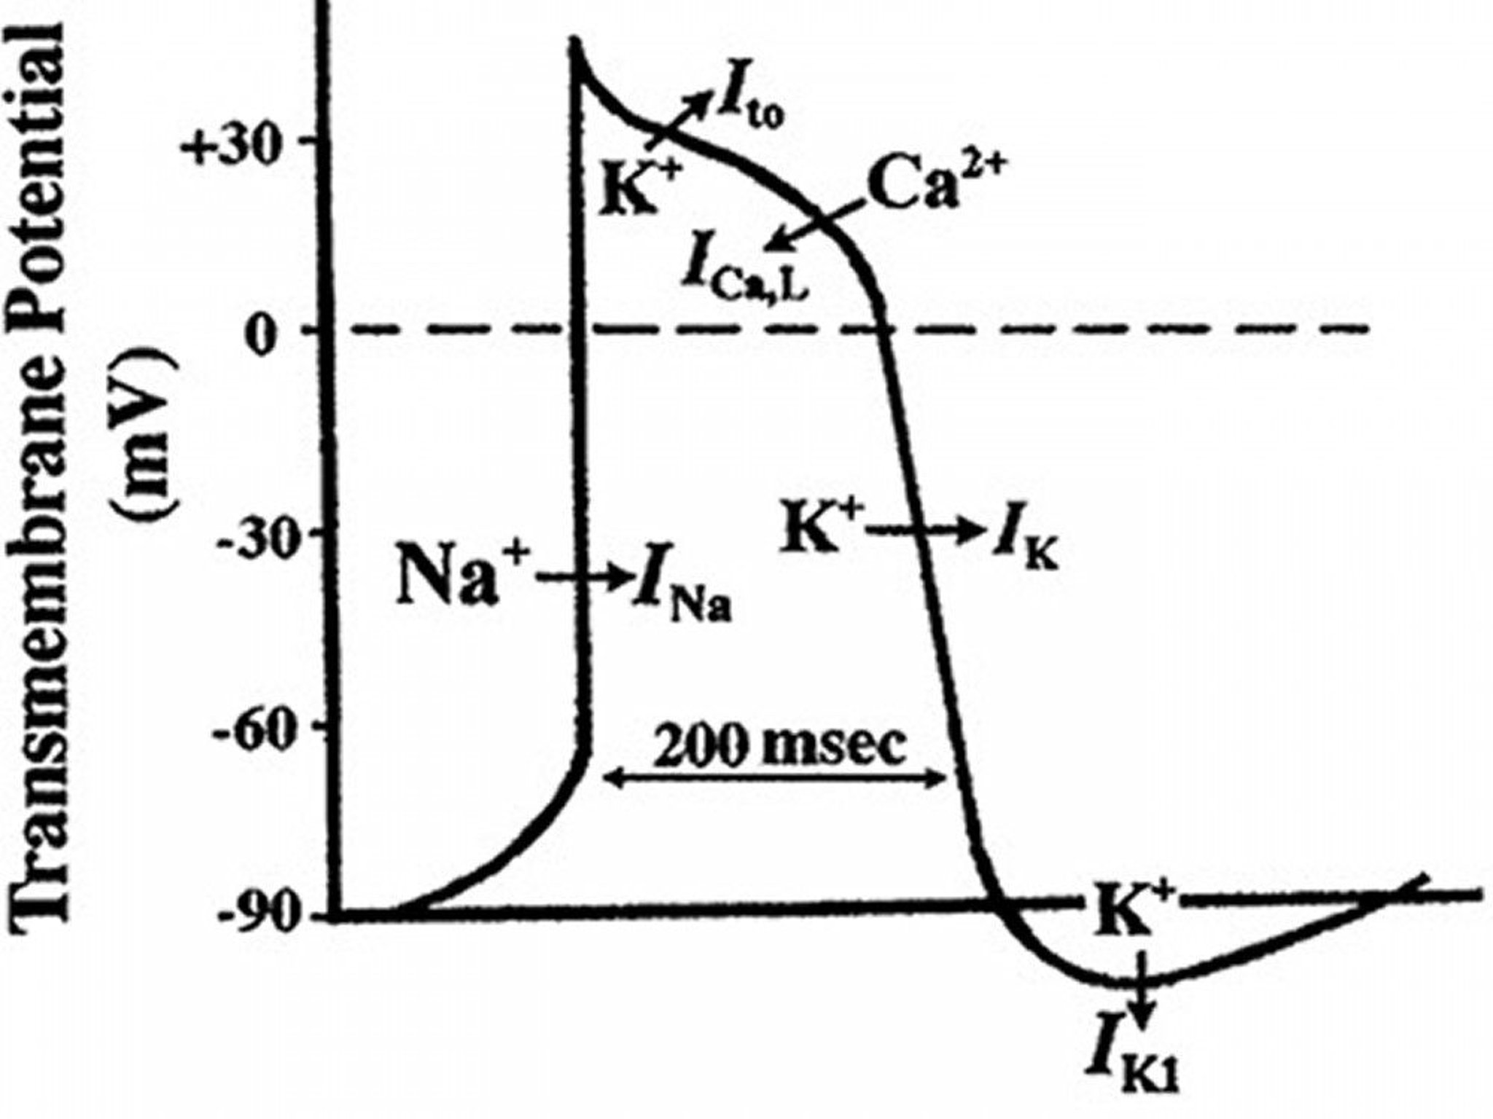
Cardiac Action Potential

Slide 6
Pathophysiology of Arrhythmias
Rhythm disturbances result from abnormalities of impulse formation, impulse conduction, or both.
Bradyarrhythmias result from decreased intrinsic pacemaker function or blocks in conduction, principally within the AV node or the His-Purkinje system.
Most tachyarrhythmias are caused by reentry; some result from enhanced normal automaticity or from abnormal mechanisms of automaticity.

Slide 7
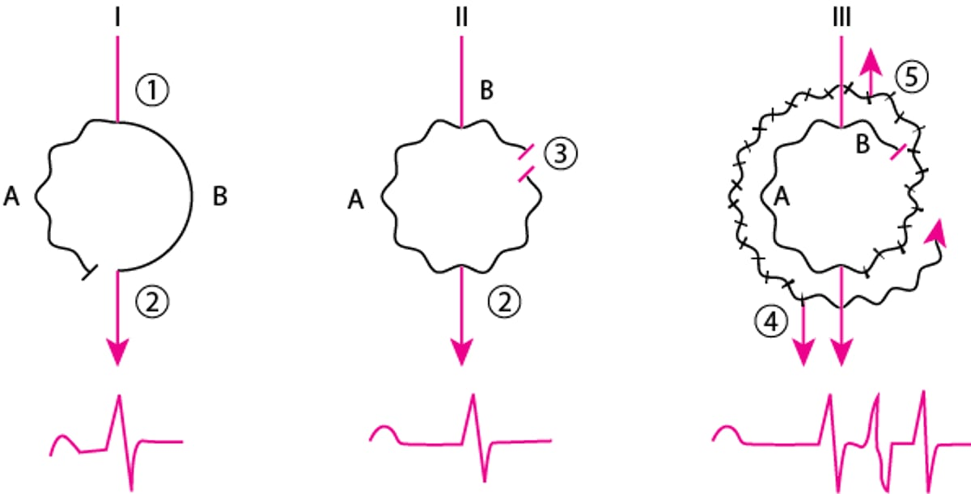
Mechanism of Typical Reentry

Slide 8
Symptoms of Arrhythmias
Arrhythmia and conduction disturbances may be asymptomatic or cause palpitations, symptoms of hemodynamic compromise, or cardiac arrest. Occasionally, polyuria results from release of atrial natriuretic peptide during prolonged supraventricular tachycardias (SVTs).

Slide 9
Signs of Arrhythmias
Palpation of pulse and cardiac auscultation can determine ventricular rate and its regularity or irregularity. Examination of the jugular venous pulse waves may help in the diagnosis of AV blocks and tachyarrhythmias. For example, in complete AV block, the atria intermittently contract when the AV valves are closed, producing large a (cannon) waves in the jugular venous pulse.

Slide 10
Diagnosis of arrhythmias
History and physical examination may detect an arrhythmia and suggest possible causes, but diagnosis requires a 12-lead ECG or, less reliably, a rhythm strip, preferably obtained during symptoms to establish the relationship between symptoms and rhythm.
The ECG is approached systematically; calipers measure intervals and identify subtle irregularities.
The key diagnostic features are:
1. Rate and regularity of atrial activation.
2. Rate and regularity of ventricular activation.
3. The relationship between the two.

Slide 11
Diagnosis of arrhythmias
A narrow QRS complex (< 0.12 seconds) indicates a supraventricular origin (above the His bundle bifurcation).
A wide QRS complex (≥ 0.12 seconds) indicates a ventricular origin (below the His bundle bifurcation) or a supraventricular rhythm conducted with an intraventricular conduction defect or with ventricular preexcitation in the Wolff-Parkinson-White syndrome.

Slide 12
Bradyarrhythmias
Bradyarrhythmias have a slow ventricular rate (< 60 beats/minute in adults).
ECG diagnosis of bradyarrhythmias depends on the presence or absence of P waves, morphology of the P waves, and the relationship between P waves and QRS complexes.

Slide 13
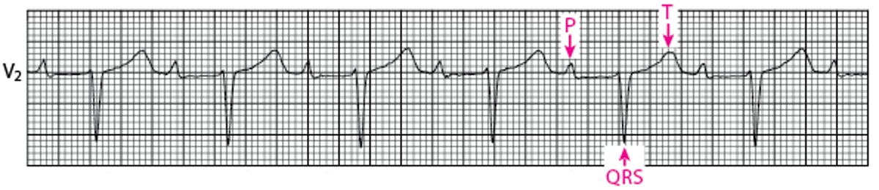
First degree heart block
For first-degree block, conduction is slowed without skipped beats. All normal P waves are followed by QRS complexes, but the PR interval is longer than normal (> 0.2 second).

Slide 14
Second-degree AV block
Some normal P waves are followed by QRS complexes, but some are not.
Two types exist:
1. Mobitz type I.
2. Mobitz type II.

Slide 15
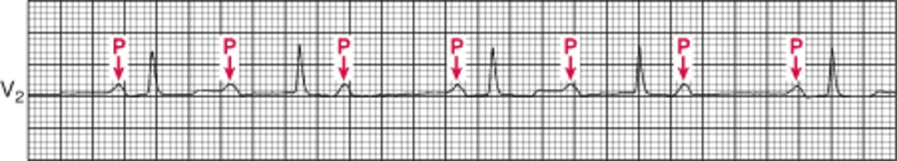
Mobitz type I
The PR interval progressively lengthens with each beat until the atrial impulse is not conducted and the QRS complex is dropped (Wenckebach phenomenon); atrioventricular nodal conduction resumes with the next beat, which has the shortest PR interval, and the sequence is repeated.

Slide 16
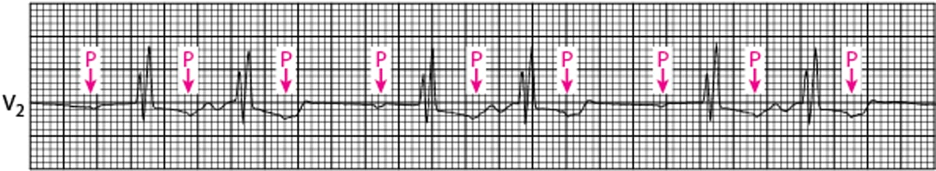
Mobitz type II
The PR interval remains constant. Beats are intermittently nonconducted, and QRS complexes dropped, usually in a repeating cycle of every third (3:1 block) or fourth (4:1 block) P wave.

Slide 17
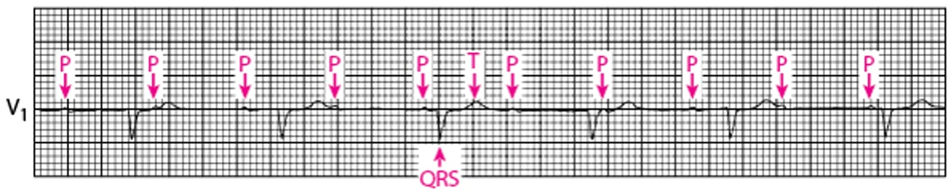
Third-degree AV block
There is no relationship between P waves and QRS complexes (AV dissociation) in third-degree AV block. The P wave rate is greater than the QRS rate.

Slide 18
Tachyarrhythmias
Tachyarrhythmias have a rapid ventricular rate (> 100 beats/minute in resting adults).
Tachyarrhythmias may be divided into 4 groups, defined by the QRS complexes:
- Visibly regular vs irregular QRS complexes.
- Narrow vs wide QRS complexes.

Slide 19
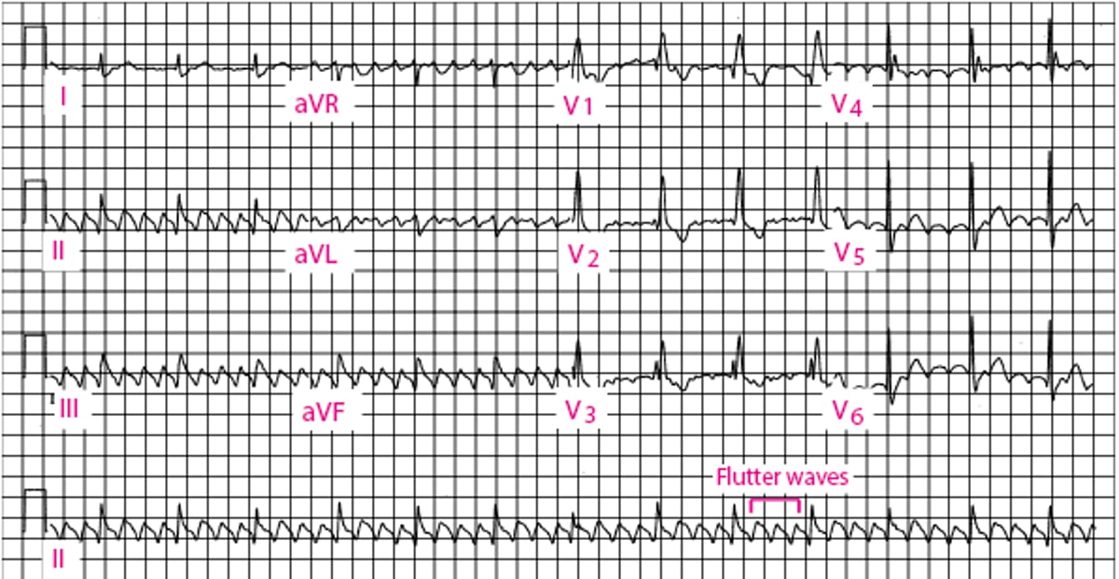
Atrial Flutter
The diagnosis of atrial flutter is by electrocardiography (ECG). In typical flutter, ECG shows continuous and regular atrial activation with a sawtooth pattern, most obvious in leads II, III, and aVF.

Slide 20
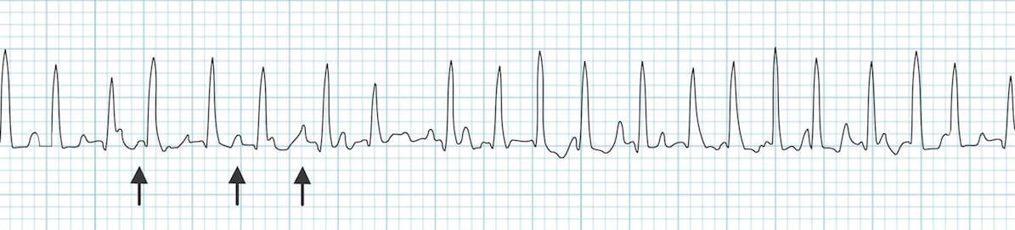
Multifocal atrial tachycardia
Multifocal atrial tachycardia (chaotic atrial tachycardia) is an irregularly irregular rhythm caused by the random discharge of multiple ectopic atrial foci.
By definition, heart rate is > 100 beats/minute.
On ECG, P-wave morphology differs from beat to beat, and there are ≥ 3 distinct P-wave morphologies.
The presence of P waves distinguishes multifocal atrial tachycardia from atrial fibrillation.

Slide 21
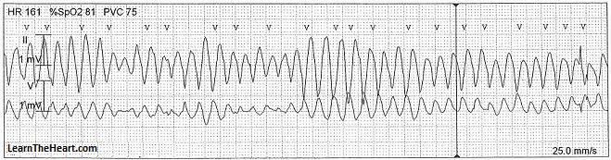
Polymorphic VT
Polymorphic ventricular tachycardia (PVT) is a form of ventricular tachycardia in which there are multiple ventricular foci with the resultant QRS complex varying in amplitude, axis, and duration. The most common cause of PVT is myocardial ischemia/infarction.

Slide 22
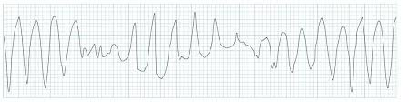
Torsades de pointes
Torsades de pointes (TdP) is a specific form of PVT occurring in the context of QT prolongation — it has a characteristic morphology in which the QRS complexes “twist” around the isoelectric line.

Slide 23
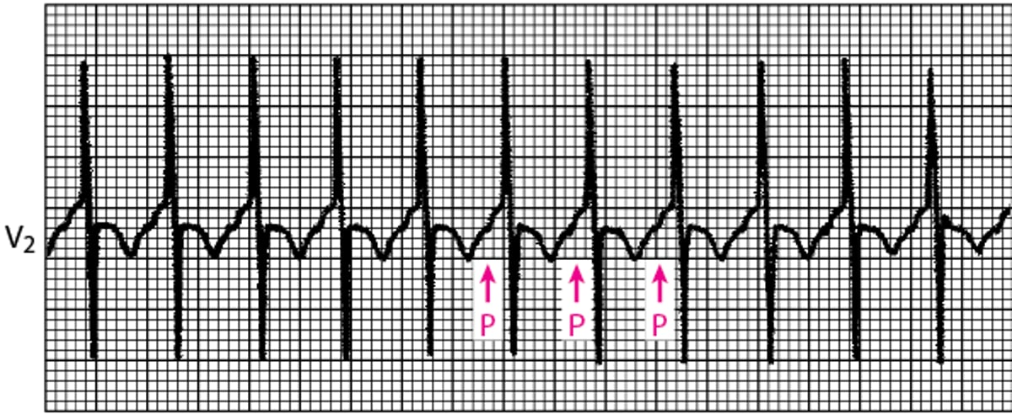
Focal atrial tachycardia
This narrow QRS tachycardia arises from an abnormal automatic focus or micro-reentry. P waves precede the QRS complexes; it is often a long RP interval tachycardia (PR < RP) but may be a short RP tachycardia (PR > RP) if atrioventricular nodal conduction is slow.

Slide 24
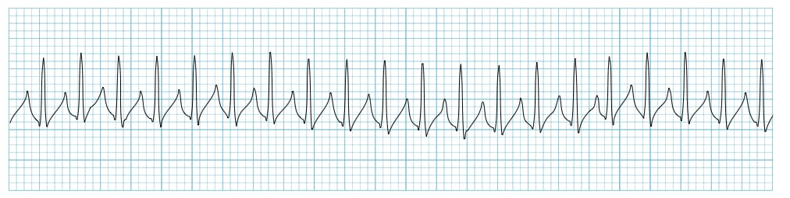
Paroxysmal supraventricular tachycardia
Reentrant (paroxysmal) supraventricular tachycardias (PSVT) involve reentrant pathways with a component above the bifurcation of the His bundle. Subtypes include atrioventricular nodal reentrant tachycardia (AVNRT), atrioventricular reentrant tachycardia (AVRT) using an accessory pathway, atrial reentrant tachycardia, and sinus nodal reentrant tachycardia.

Slide 25
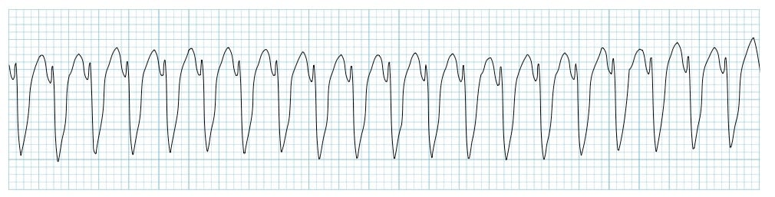
Monomorphic ventricular tachycardia
Ventricular Tachycardia (VT) is a broad complex tachycardia originating from the ventricles.
Monomorphic VT, is a form of VT which originates from a single focus within the ventricles.

Slide 26
Atrial fibrillation
Atrial fibrillation (AF) is the most common sustained arrhythmia.
It is characterized by disorganized atrial electrical activity and contraction.
The incidence and prevalence of AF is increasing.
Lifetime risk over the age of 40 years is ~25%.
Complications of AF include hemodynamic instability, cardiomyopathy, cardiac failure, and embolic events such as stroke.

Slide 27
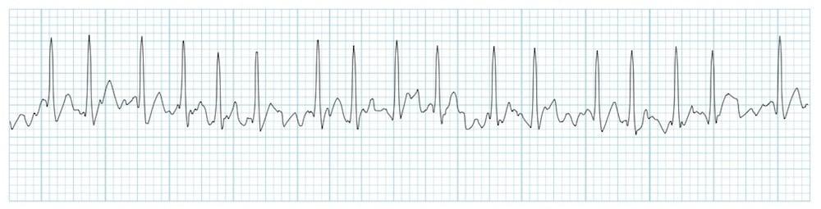
Atrial fibrillation
ECG Features of Atrial Fibrillation
Irregularly irregular rhythm, no P waves, absence of an isoelectric baseline and variable ventricular rate.
QRS complexes usually < 120ms, unless pre-existing bundle branch block, accessory pathway, or rate-related aberrant conduction.
Fibrillatory waves may be present and can be either fine (amplitude < 0.5mm) or coarse (amplitude > 0.5mm). Fibrillatory waves may mimic P waves leading to misdiagnosis.

Slide 28
Prevention of thromboembolism
Long-term measures to prevent thromboembolism are taken for certain patients with atrial fibrillation depending on their estimated risk of stroke versus risk of bleeding.
We can use VKAs or DOAs to prevent thrombosis.
Target INR is 2-3 if we use VKAs.

Slide 30
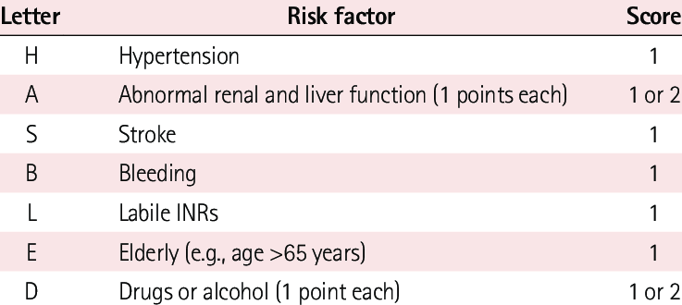
HAS BLED Score

Slide 34
Treatment of arrhythmias
Treatment is directed at causes.
If necessary, direct antiarrhythmic therapy is used.
Direct antiarrhythmic therapy includes, either alone or in combination:
Antiarrhythmic drugs.
Cardioversion-defibrillation.
Implantable cardioverter-defibrillators (ICDs).
Pacemakers (and a special form of pacing, cardiac resynchronization therapy).
Catheter ablation.
Surgery.

Slide 35
Syncope
Syncope is a sudden, brief loss of consciousness with loss of postural tone followed by spontaneous revival.
The patient is motionless and limp and usually has cool extremities, a weak pulse, and shallow breathing.
Sometimes brief involuntary muscle jerks occur, resembling a seizure.

Slide 36
Pathophysiology of Syncope
Most syncope results from insufficient cerebral blood flow. Some cases involve adequate flow but with insufficient cerebral substrate (oxygen, glucose, or both).
Most deficiencies in cerebral blood flow result from decreased cardiac output (CO).
Decreased CO can be caused by cardiac disorders that obstruct outflow, cardiac disorders of systolic dysfunction, cardiac disorders of diastolic dysfunction, arrhythmias (too fast or too slow) and conditions that decrease venous return.

Slide 37
Etiology of Syncope
The most common causes are:
1. Vasovagal (neurocardiogenic).
2. Idiopathic.
Many cases of syncope never have a firm diagnosis but lead to no apparent harm.
A smaller number of cases have a serious cause, usually cardiac.

Slide 38
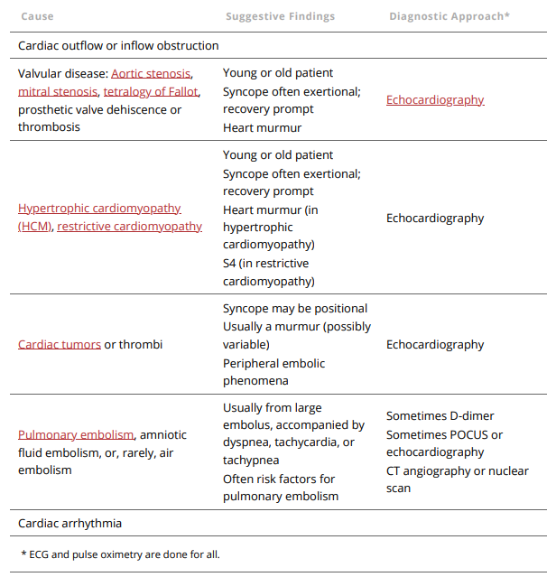
Some causes of syncope
Evaluation should be done as soon as possible after the event.
The more remote the syncopal event, the more difficult the diagnosis.
Information from witnesses is quite helpful and best obtained as soon as possible.

Slide 39
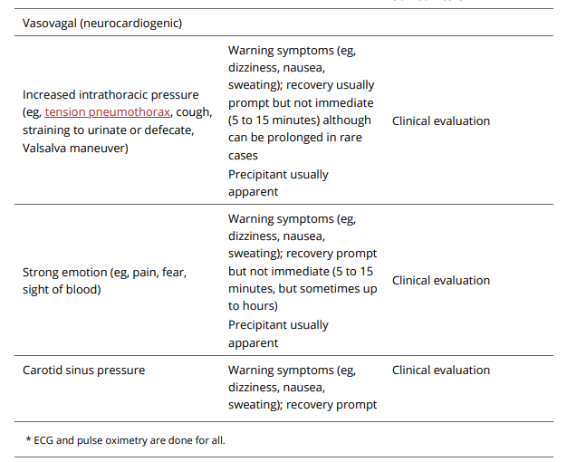
Some causes of syncope

Slide 40
Red flags of syncope
Certain findings suggest a more serious etiology:
Syncope during exertion.
Multiple recurrences within a short time.
Heart murmur or other findings suggesting structural heart disease (eg, chest pain).
Older age.
Significant injury during syncope.
Family history of sudden unexpected death, exertional syncope, or unexplained recurrent syncope or seizures.

Slide 41
Tests used in diagnosis of syncope
Testing typically is done:
ECG.
Pulse oximetry.
Echocardiography.
Tilt table testing.
Blood tests only if clinically indicated.
Central nervous system imaging rarely indicated.

Slide 42
Treatment of syncope
In witnessed syncope, pulses are checked immediately.
If the patient is pulseless, CPR is begun.
If pulses are present, severe bradycardia is treated with atropine or external transthoracic pacing.
Isoproterenol can be used to maintain adequate heart rate while a temporary pacemaker is placed.

Slide 43
Treatment of syncope
Tachyarrhythmias are treated; a direct-current synchronized shock is quicker and safer than medications for patients who are not stable.
Inadequate venous return is treated by keeping the patient supine, raising the legs, and giving IV normal saline.
Tamponade is relieved by pericardiocentesis.
Tension pneumothorax requires insertion of a pleural cannula and drainage.

Slide 44
Treatment of syncope
Specific treatment depends on the cause and its pathophysiology.
Driving and use of machinery should be prohibited until the cause is determined and treated.
Geriatrics Essential

Slide 45
Thank You
Armed Forces College of Medicine
AFCM

